Slide 1
Introduction to jQuery
A detailed guide to jQuery concepts, examples, and usage

Slide 2
History & Evolution of jQuery
- Timeline of jQuery development (2006-present)
- Evolution from version 1.x to 3.x
- Key milestones: jQuery 1.x (initial release), 2.x (removed IE6-8 support), 3.x (performance improvements).

Slide 3
jQuery vs JavaScript
JavaScript
Definition: A high-level, interpreted programming language used to create dynamic and interactive effects within web browsers.
Core Language: It's the core scripting language of the web.Browser.
Support: Supported natively by all browsers.Syntax: More verbose when handling DOM elements, events, and AJAX.
Performance: Faster because it runs natively.
Example
document.getElementById("btn").addEventListener("click", function() { alert("Clicked!"); });

Slide 4
jQuery vs JavaScript
JQuery
Definition: A JavaScript library designed to simplify HTML DOM tree traversal and manipulation, as well as event handling, CSS animation, and AJAX.
Built With: Written in JavaScript.
Ease of Use: Easier syntax, cross-browser compatibility, and less code.
Performance: Slightly slower than vanilla JS (due to abstraction).
Features: Animations, event handling, simplified AJAX, effects, etc.
$("#btn").click(function() { alert("Clicked!"); });

Slide 5
Advantages of jQuery over Vanilla JS (Javascript)
- Simplified syntax: $('#id') vs document.getElementById('id')
- Cross-browser compatibility
- Shortened code for complex operations (animations, AJAX).

Slide 6
jQuery Version Differences
- jQuery 1.x: Supports older browsers (IE6-8)
- jQuery 2.x: Removed support for older browsers
- jQuery 3.x: Performance improvements and modern features.

Slide 7
Installing jQuery
- CDN vs Local Download: Benefits of CDN (faster, reliable) vs local download.
- How to Include:
<script src="https://code.jquery.com/jquery-3.6.0.min.js"></script> for CDN.
- Local download: How to download and link jQuery locally.

Slide 8
Using jQuery with VS Code/IDE
- Steps to integrate jQuery with VS Code.
- Proper linking in HTML file.
- How to start writing jQuery code.

Slide 9
Debugging jQuery Code
- Console logging: console.log() for checking jQuery output.
- Using Developer Tools: Inspect elements, check jQuery versions.

Slide 10
jQuery Syntax & Selectors
- Basic syntax: $(selector).action().
- Selectors: ID (#id), class (.class), element (div), universal (*).
Example: $('#myElement').css('color', 'red');

Slide 11
Event Handling in jQuery
- Event Handling refers to the process of responding to user interactions or browser actions on a web page — such as clicking a button, typing in an input field, submitting a form, or moving the mouse.
Why Use Event Handling?
Event handling helps make your web page interactive and dynamic. For example:
Clicking a button to show/hide content.
Typing in a text box and triggering auto-suggestions.
Submitting a form and validating input without reloading the page.

Slide 12
Event Handling in jQuery
- Mouse events: click(), dblclick(), hover().
- Keyboard events: keypress(), keydown().
- Form events: submit(), focus(), blur().
- Event delegation: $(parent).on('event', 'child', function() {...});
Example: $('#btn').click(function() { alert('Button clicked!'); })

Slide 13
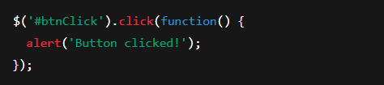
Event Handling in jQuery
- Mouse events: click(), dblclick(), hover().
Event Handling in jQuery
🔹 Mouse Events
click() Description: Triggers when an element is clicked.
Use Case: Used for buttons, images, or any clickable elements.

Slide 14

Event Handling in jQuery
- Mouse events: click(), dblclick(), hover().
Event Handling in jQuery
🔹 Mouse Events
dblclick() Description: Triggers when an element is double-clicked.

Slide 15
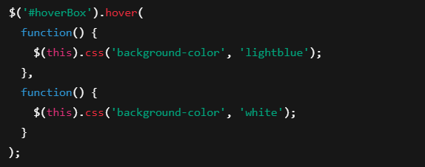
Event Handling in jQuery
- Mouse events: click(), dblclick(), hover().
Event Handling in jQuery
🔹 Mouse Events
hover() Description: Binds handlers for both mouseenter and mouseleave events.

Slide 16

Event Handling in jQuery
- Keyboard events: keypress(), keydown().
Event Handling in jQuery
🔹 Keyboard Events
keypress() Description: Fires when a key that produces a character value is pressed down.

Slide 17

Event Handling in jQuery
- Keyboard events: keypress(), keydown().
Event Handling in jQuery
🔹 Keyboard Events
keydown() Description: Fires when any key is pressed down (including function keys).

Slide 18
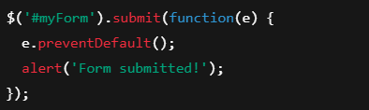
Event Handling in jQuery
- Form events: submit(), focus(), blur().
Event Handling in jQuery
🔹 Form Events
submit()
Description: Triggers when a form is submitted.

Slide 19

Event Handling in jQuery
- Form events: submit(), focus(), blur().
Event Handling in jQuery
🔹 Form Events
focus()
Description: Fires when an element gains focus.

Slide 20

Event Handling in jQuery
- Form events: submit(), focus(), blur().
Event Handling in jQuery
🔹 Form Events
blur()
Description: Fires when an element loses focus.

Slide 21

Event Handling in jQuery
Event Handling in jQuery
🔹 Event Delegation
Description: Binds an event to a parent element to handle events for its child elements, especially useful for dynamically added elements.

Slide 22

Quick Example Recap
Event Handling in jQuery
Description: Shows an alert message when the button with id="btn" is clicked.

Slide 23
DOM Manipulation with jQuery
- DOM (Document Object Model) manipulation means changing, adding, or removing HTML elements and content dynamically using jQuery.
- Adding/removing elements: .append(), .remove().
- HTML/Text manipulation: .html(), .text().
- Class and CSS manipulation: .addClass(), .css().
Example: $('#newElement').append('<p>New paragraph!</p>');

Slide 24

DOM Manipulation with jQuery
- Adding/Removing Elements
.append() Description: Adds content inside the selected element, at the end.
Use Case: Add new items to a list, messages to a chat box, etc.

Slide 25

DOM Manipulation with jQuery
- Adding/Removing Elements
.remove() Description: Removes the selected element(s) from the DOM.
Use Case: Delete old or unnecessary elements dynamically.

Slide 26

DOM Manipulation with jQuery
- Class and CSS Manipulation
.addClass() Description: Adds one or more CSS classes to selected elements.
Use Case: Apply predefined styles via class (e.g., animations, themes).

Slide 27
DOM Manipulation with jQuery
- Class and CSS Manipulation
.css() Description: Gets or sets inline CSS styles.
Use Case: Dynamically change element styles without modifying CSS files.

Slide 28
Effects and Animations
- Basic effects: hide(), show(), toggle().
- Fade effects: fadeIn(), fadeOut().
- Slide effects: slideUp(), slideDown().
- Custom animations: .animate().
Example: $('#element').fadeIn();

Slide 29

Effects and Animations
Basic Effects
.hide() Description: Hides the selected element(s).

Slide 30
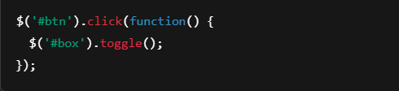
Effects and Animations
Basic Effects
.toggle() Description: Toggles between showing and hiding an element.

Slide 31

Effects and Animations
Fade Effects
.fadeIn()
Description: Gradually makes a hidden element visible with a fade effect.

Slide 32

Effects and Animations
Fade Effects
.fadeOut()
Description: Fades out and hides the selected element.

Slide 33

Effects and Animations - Slide Effects
Slide Effects
.slideUp()
Description: Slides the element up and hides it.

Slide 34

Effects and Animations - Slide Effects
Slide Effects
.slideDown()
Description: Slides the element down and shows it.

Slide 35
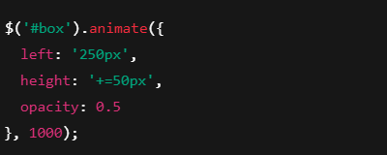
Effects and Animations - Custom Animations
Custom Animations
.animate()
Description: Allows you to create custom animations by changing multiple CSS properties over time.

Slide 36
Chaining and Callbacks
- Method chaining: Perform multiple actions in one line.
- Callbacks: Functions executed after an animation.
Example: $('#element').fadeOut().fadeIn();

Slide 37
Method chaining
jQuery allows you to perform multiple actions on the same element in a single line, by chaining methods together.
This improves readability and reduces repetitive code.
Example: $('#element').fadeOut().fadeIn();

Slide 38

Callbacks
A callback is a function that is executed after the previous function completes.
Especially useful for animations where you want to trigger something after the effect finishes.
Syntax: $(selector).fadeOut(speed, callback);

Slide 39
AJAX with jQuery
- Basic methods: .load(), .get(), .post().
- $.ajax() full usage for advanced requests.
Example: $.ajax({ url: 'data.json', success: function(data) { console.log(data); }});

Slide 40

AJAX with jQuery
.load()
Description: Loads data from the server and inserts it into the selected element.
Use Case: Load HTML snippets or partial pages into a div.

Slide 41
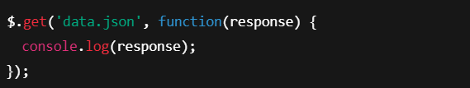
AJAX with jQuery
.get()
Description: Sends an HTTP GET request and fetches data.
Use Case: Retrieve data from a server (e.g., JSON, HTML).

Slide 42
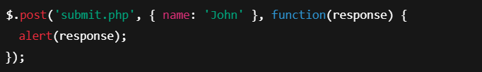
AJAX with jQuery
.post()
DescriptionSends an HTTP POST request to submit data.
Use Case: Send form or user data to a server.

Slide 43
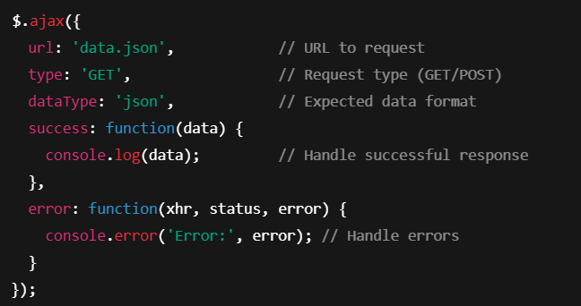
Advanced AJAX
Full Control Example:

Slide 44
Advanced AJAX
Advantages:
Set request type, headers, timeout, etc.
Handle success & error callbacks
Use for REST APIs and complex logic

Slide 45
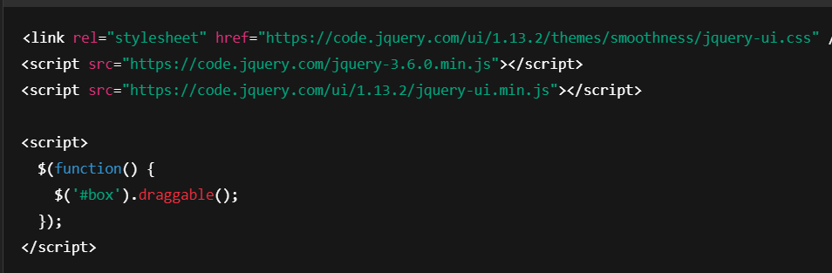
jQuery UI Components
- Draggable, Droppable.
- Accordion, Tabs, Datepicker.
Example: Make element draggable.

Slide 46
Form Validation with jQuery
- Client-side validation.
- jQuery Validation Plugin.
Example: Simple form validation.

